Slide 1
A Reusable Agent that Turn Scattered Literature into Structured Knowledge Base on Clinical Health
Azure Xia

Slide 2
Background
Rapidly growing volume of literature can be challenging to retrieve or digest
Mental health domain face the lack of “ground truth”/labeled data
Automated curation of literature is essential for scale
Large Language Models (LLMs) have emerged as powerful tools for mining large-scale information, turning scattered information into structured knowledge, to establish some “ground truth”
yet they face limitations like hallucinations
need careful design and evaluation
Notes:
“Depression and anxiety affect over 300 million people worldwide, and Yet a simple PubMed search (‘depression OR anxiety’) returns > 780 000 papers from 2000–2025—far more than any individual or guideline committee can keep up with.
LLMs can summarize large corpora, but they hallucinate, lack transparent sourcing, and ingest noisy web data. We therefore need domain‑grounded, evidence‑backed generation for mental‑health queries.”

Slide 3
Pipeline Design (Reusable and Exportable)
Step 1
Bulk retrieval
Step 2
Filtering
Step 3
Extraction
Step 4
Downstream Applications
(e.g. generate knowledge; generate Q&A bank)
Notes:
“Our pipeline has four stages (Figure 1):
Bulk retrieval of all 781 970 PubMed abstracts.
Relevance filtering by fine‑tuning a local Qwen‑32B LLM, removing non‑clinical papers.
Schema‑guided CoT extraction of Risk Factors, Populations, Interventions, and Outcomes.
Graph‑aware RAG, where we query a Neo4j graph, rank triples by TF‑IDF×PageRank, serialize them, and ask GPT‑4o to answer with explicit citations. Users interact via a lightweight chat interface that links back to each PMID.”

Slide 4
Stage 1:
Bulk Retrieval
Stage 3: Extraction
Stage 4: Optional Downstream Tasks
Stage 2: Filtering
PubMed: 1million+ papers in the past 20 years
Basic Filtering
Schema-based Extraction
Generate Knowledge
Kept
e.g., Findings
Truly on the topic?!
Classification Task
Yes/No/Uncertain Demo: if truly taking about clinical depression or anxiety
e.g., Q&A Bank
Key Info in Clinical Research
One standalone Q&A per paper
User can control which time span they’d like to research on, and how many papers they’d like to retrieve…
Demo: 100/ year from 2020-2024
Discarded
Population studied
Risk factors /causes
Treatment
Outcomes
Question
Type
Answer
Reasoning
Few-shot prompt
Notes:
“Our pipeline has four stages (Figure 1):
Bulk retrieval of all 781 970 PubMed abstracts.
Relevance filtering by fine‑tuning a local Qwen‑32B LLM, removing non‑clinical papers.
Schema‑guided CoT extraction of Risk Factors, Populations, Interventions, and Outcomes.
Graph‑aware RAG, where we query a Neo4j graph, rank triples by TF‑IDF×PageRank, serialize them, and ask GPT‑4o to answer with explicit citations. Users interact via a lightweight chat interface that links back to each PMID.”
trustworthy QA.
Users interact via a lightweight chat interface that links back to each exact instruction guideline doc.
and ask GPT‑4o to answer with explicit citations

Slide 5
Demo!
Option 1: One-Command Launch
type this command in the terminal:
./run_demo.sh
Option 2: Manual Launch
type this command in the terminal:
pip install -r requirements_demo.txt
streamlit run demo_visualization.py

Slide 6
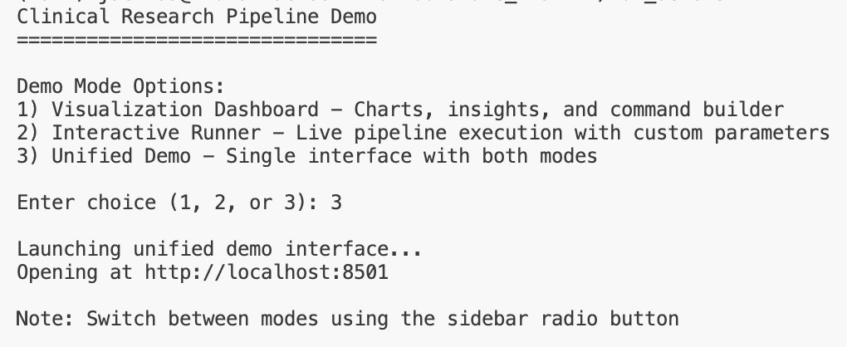
Various Interface and Sections
Once launched, choose 1, 2, or 3:
Or, you can switch sections in the sidebar:

Slide 7
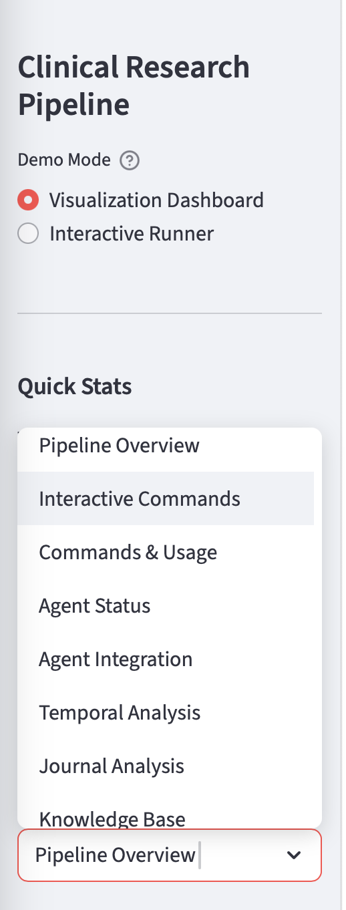
Sections Intro
1. Pipeline Overview - Shows pipeline steps, metrics
dashboard, AND data flow visualization
2. Interactive Commands - Command builder with live
parameter input
3. Commands & Usage - Static command examples
4. Agent Status - Multi-agent system status
5. Agent Integration - Export capabilities and Assignment 4
integration
6. Temporal Analysis - Research trends over time
7. Journal Analysis - Publication sources with impact
factors
8. Knowledge Base - AI-generated Q&A pairs

Slide 8
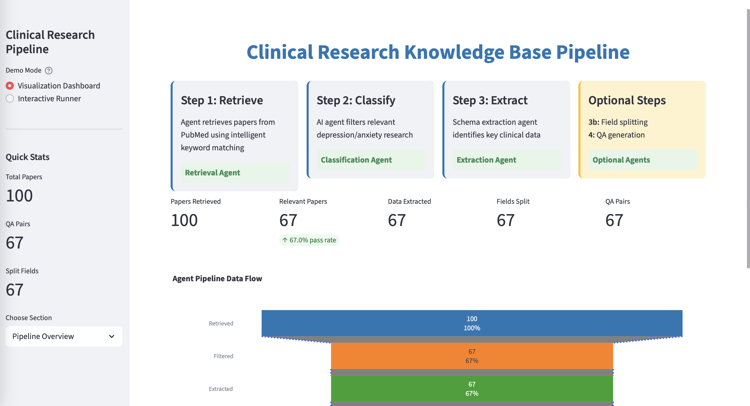
Pipeline Overview
Notes:
Sample run 20 papers in the past five years on “clinical depression and anxiety”

Slide 9
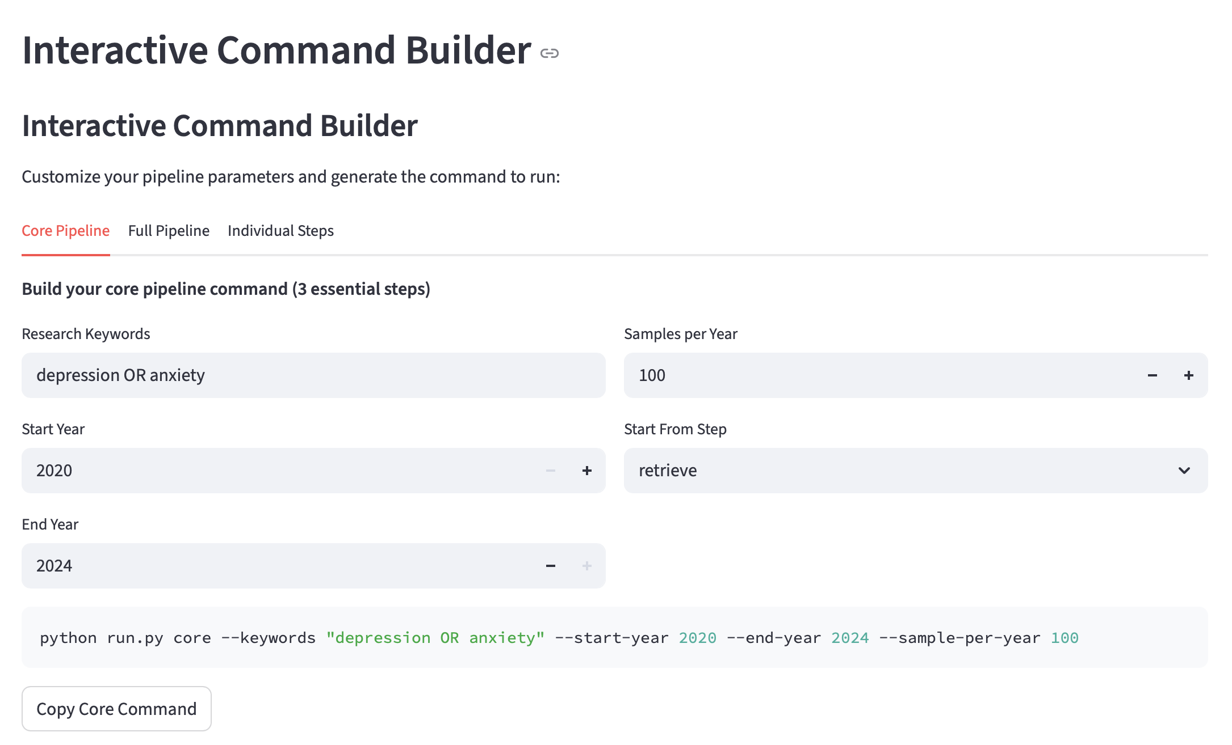
Interactive Command –User customization
Core Pipeline: Step 1, 2, and 3
Retrieve →Filter →Schema-based Extract
Full Pipeline: Core + Optional Steps
Users can input/ customize:
the topic they want to search
the time range
how many publications per year

Slide 10
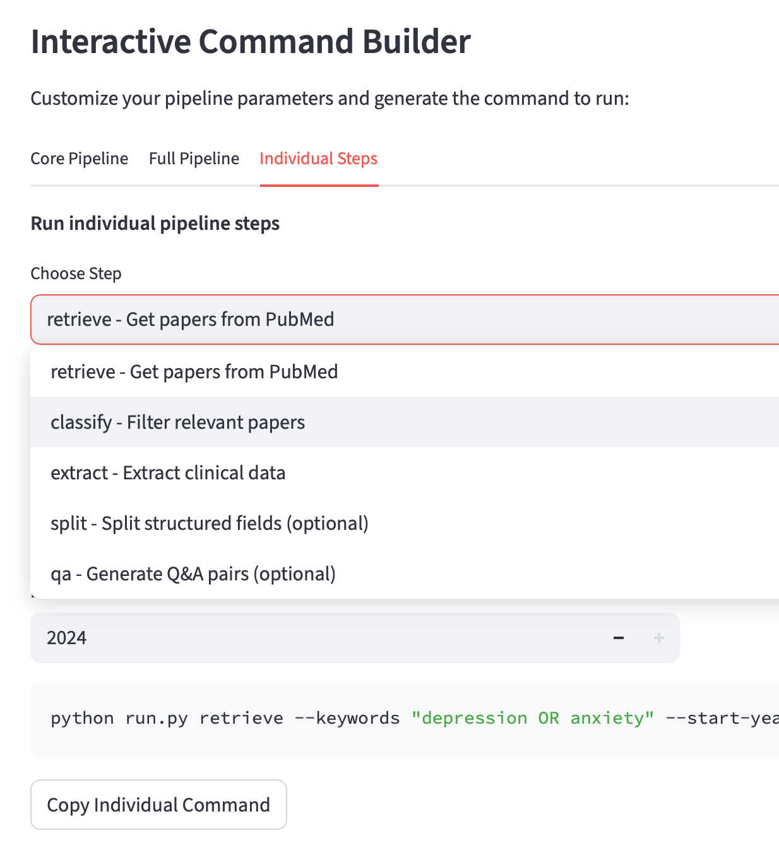
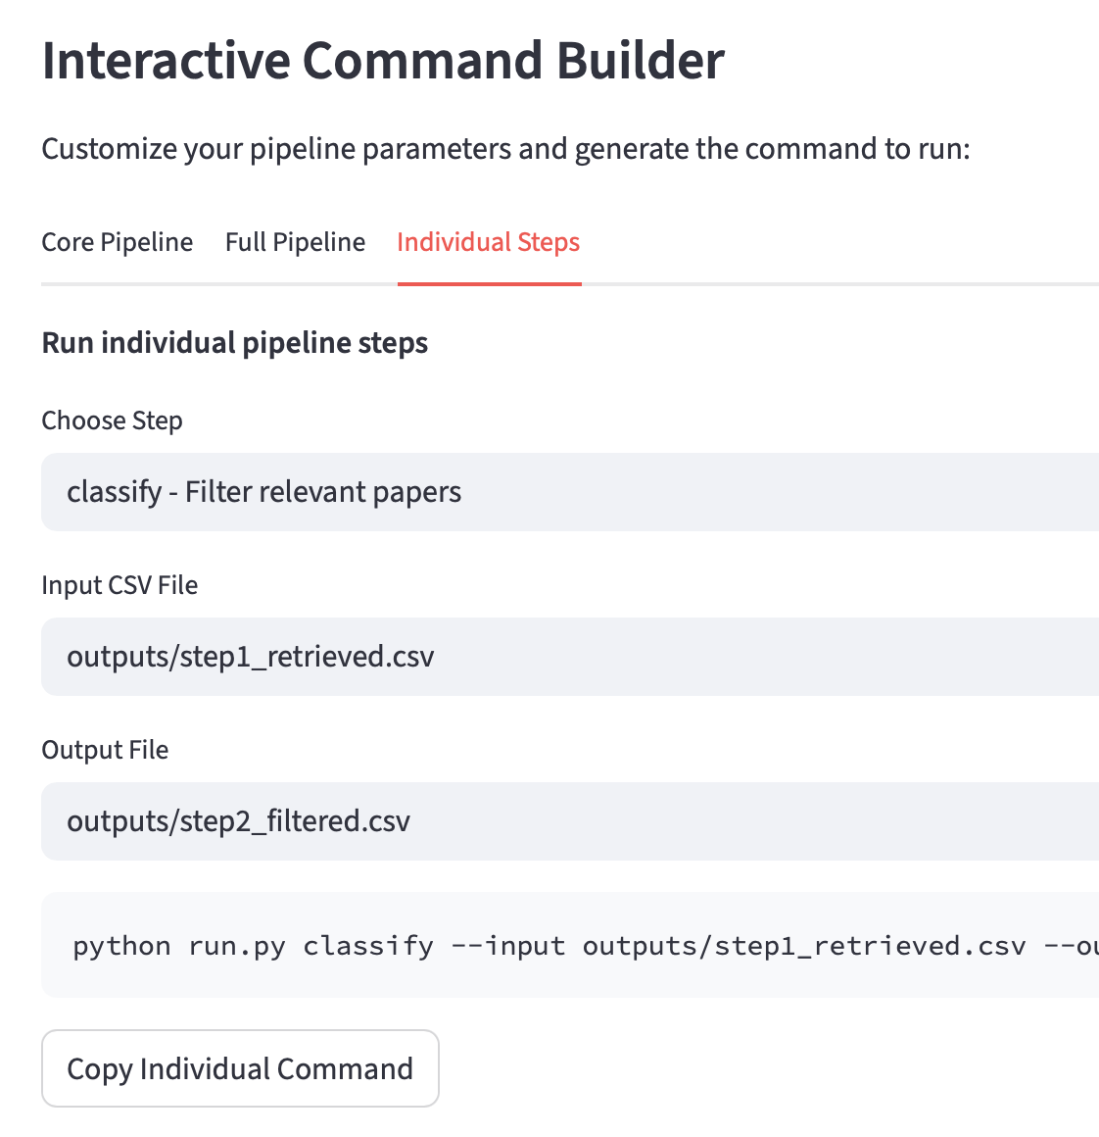
Interactive Command –Individual Step or Start
Users can run any individual step with their own input file;
Users can start from any step to the end step, using their own input file;

Slide 11
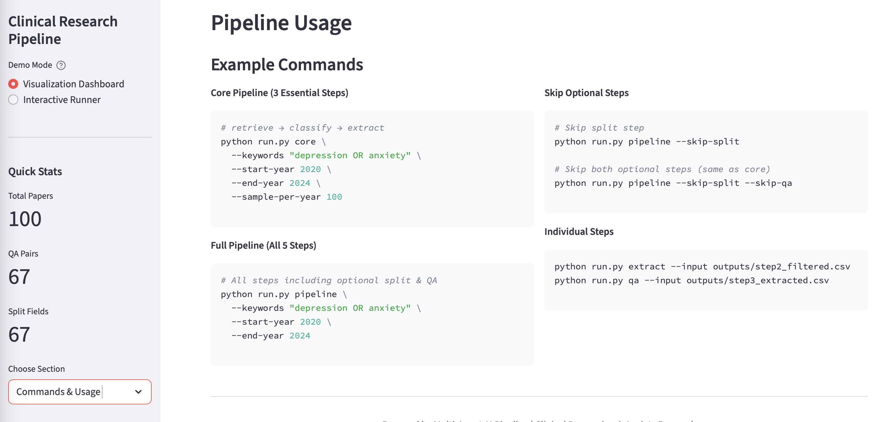
Commands Directory:

Slide 12
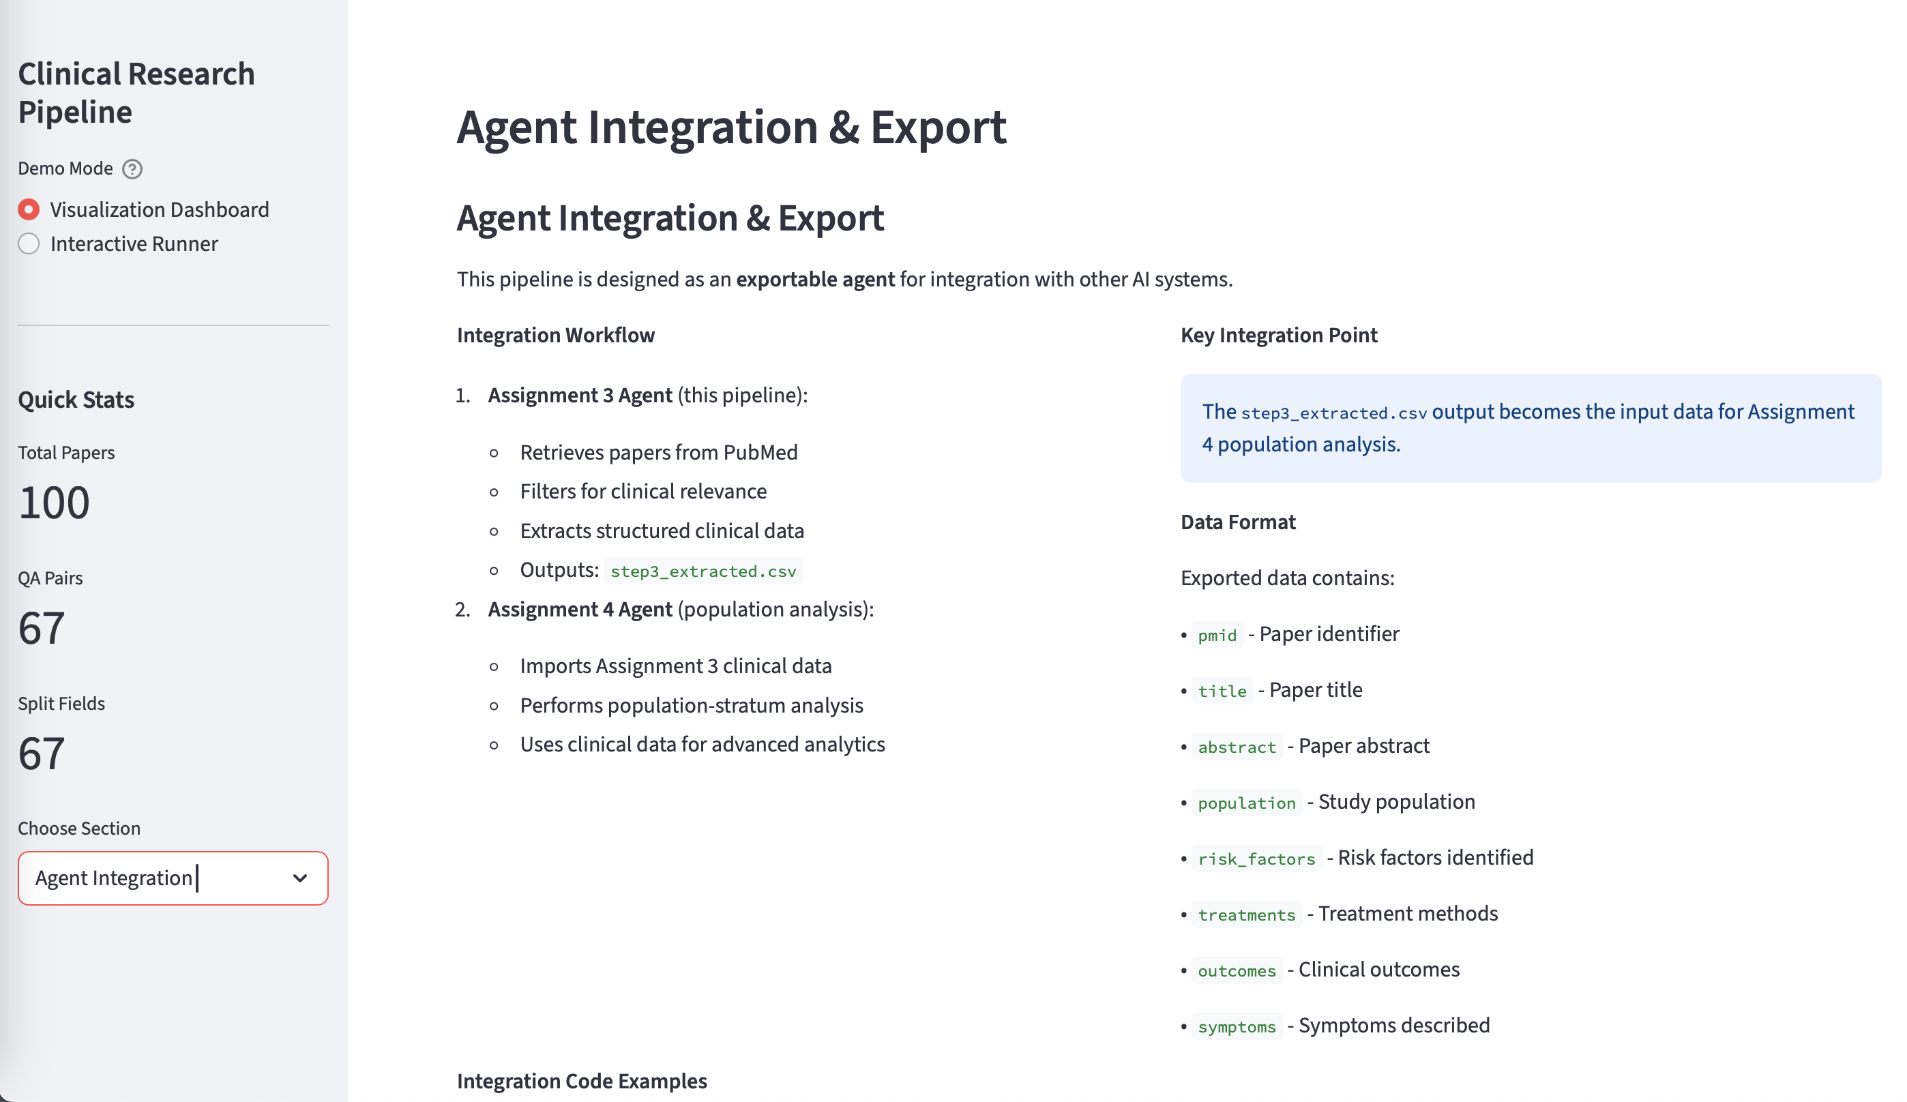
Agent is Exportable!

Slide 13
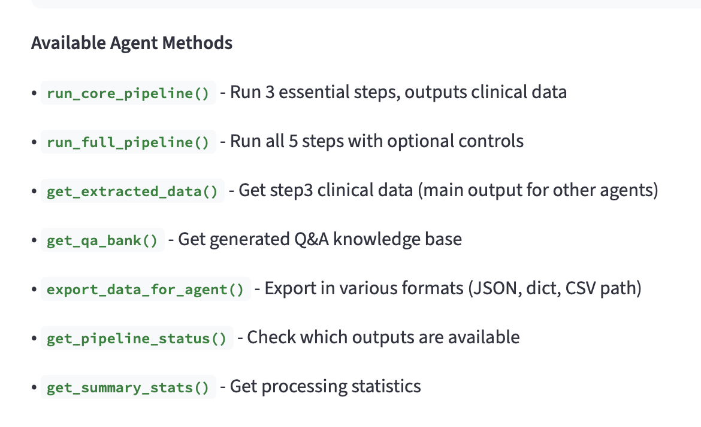
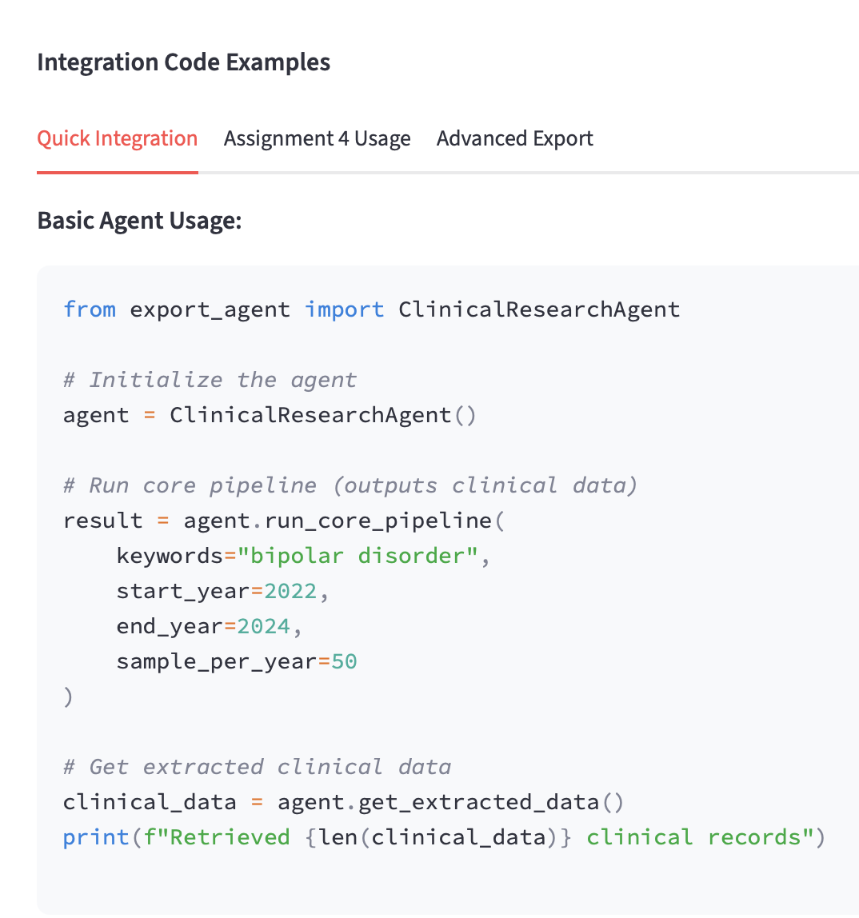
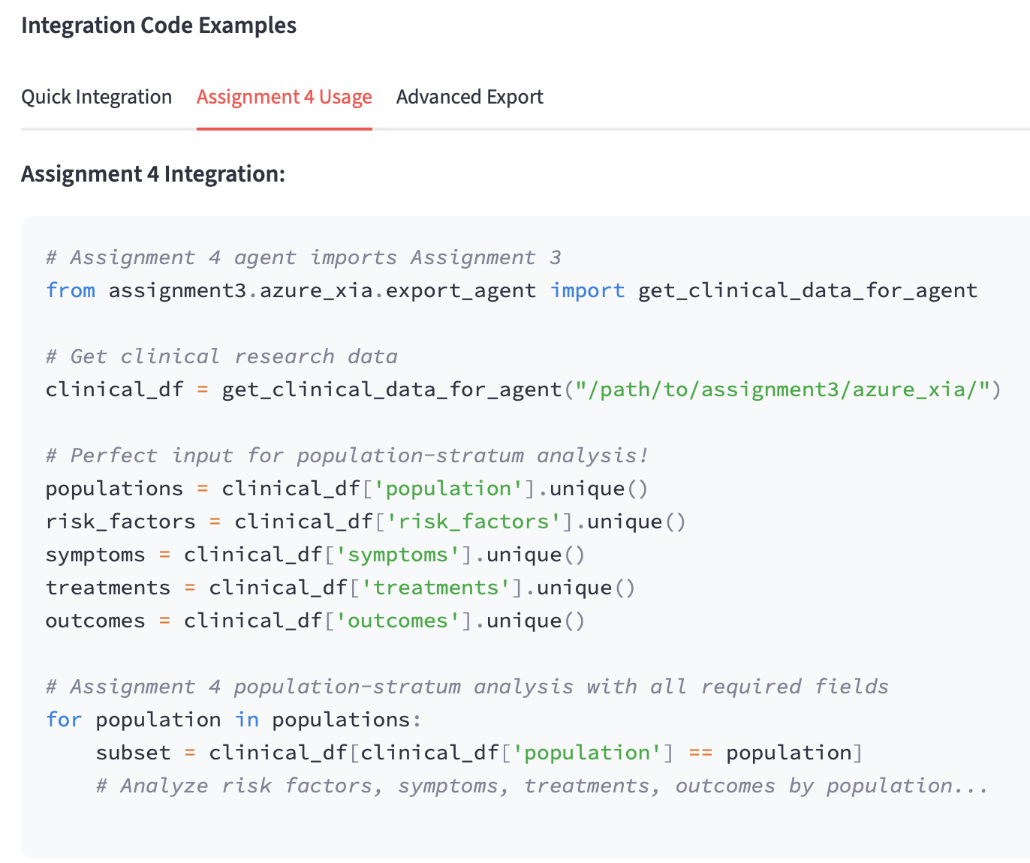
Agent Integration/Export

Slide 14
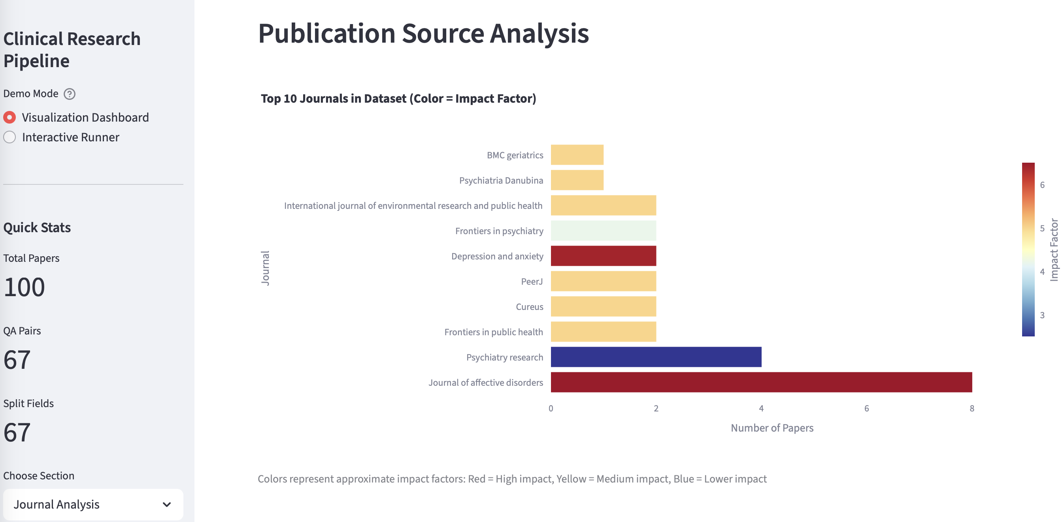
Publication Source Analysis

Slide 15
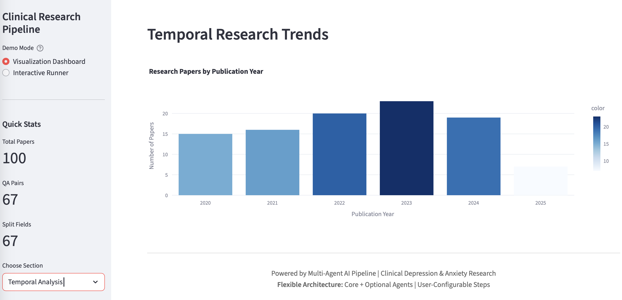
Temporal Research Trends

Slide 16
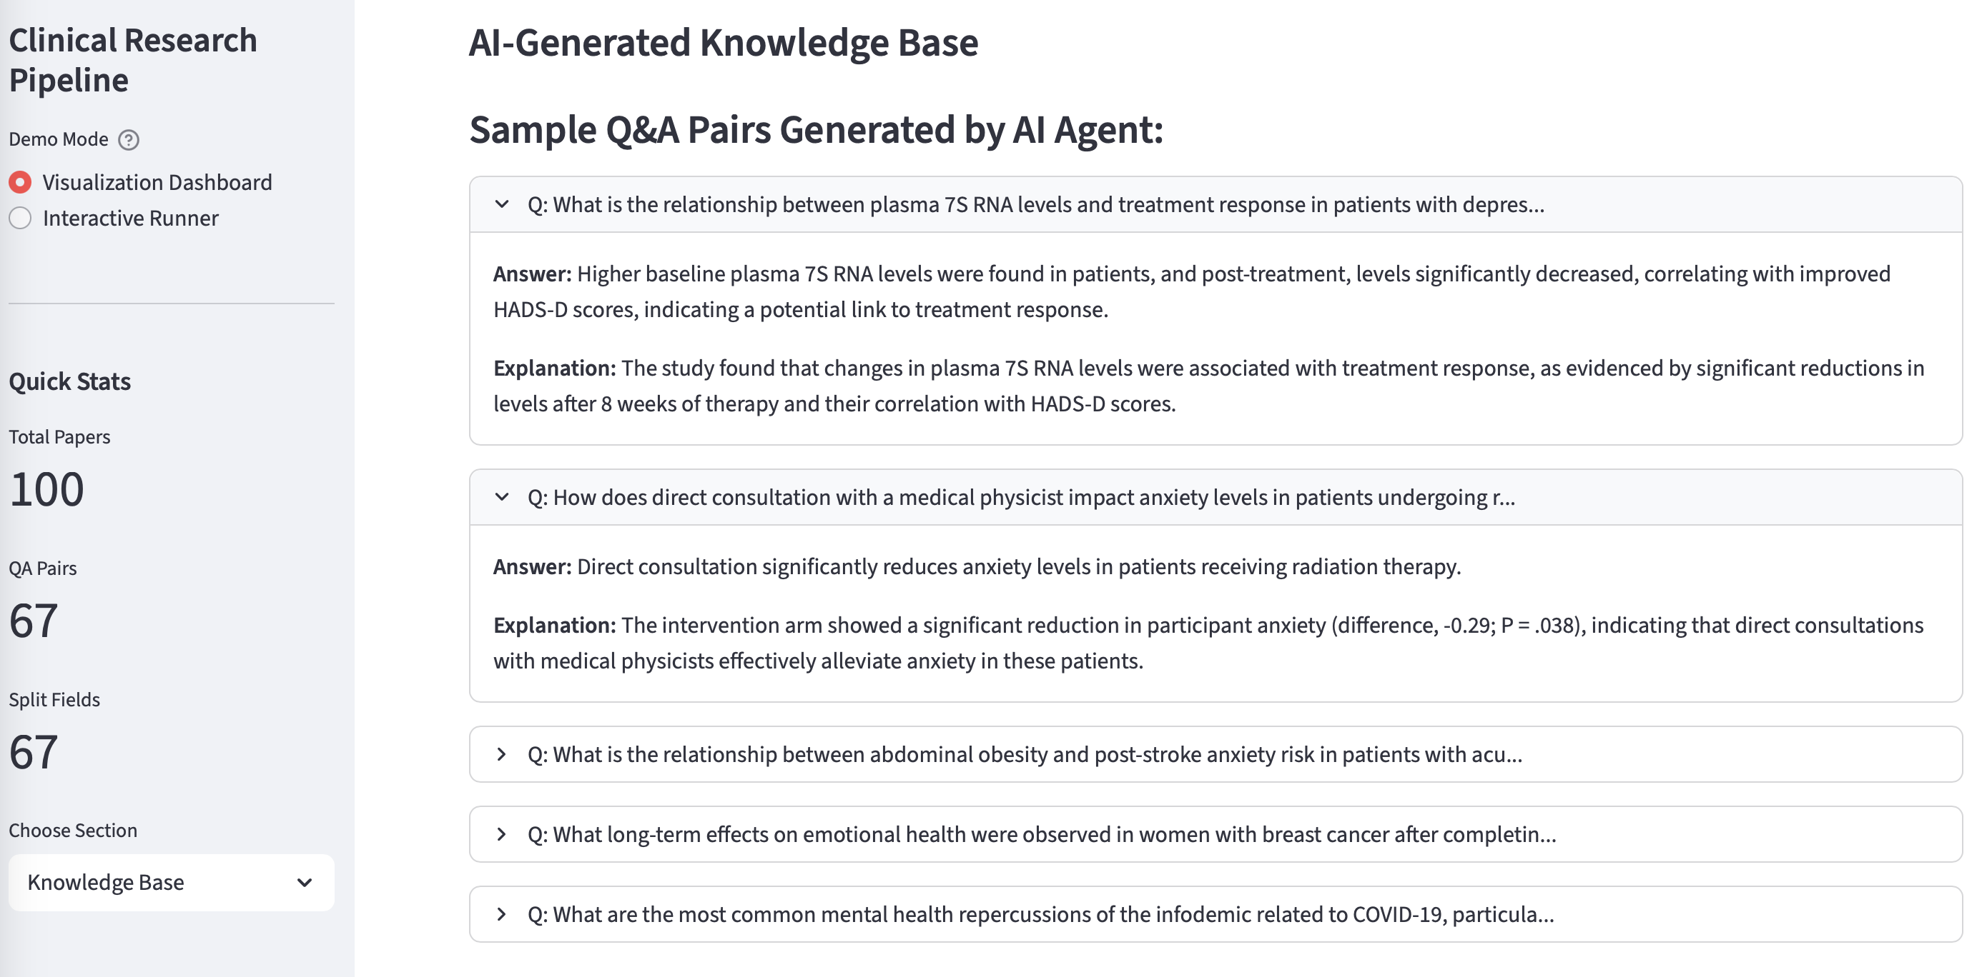
Knowledge Base Downstream: Q&A Bank

Slide 17
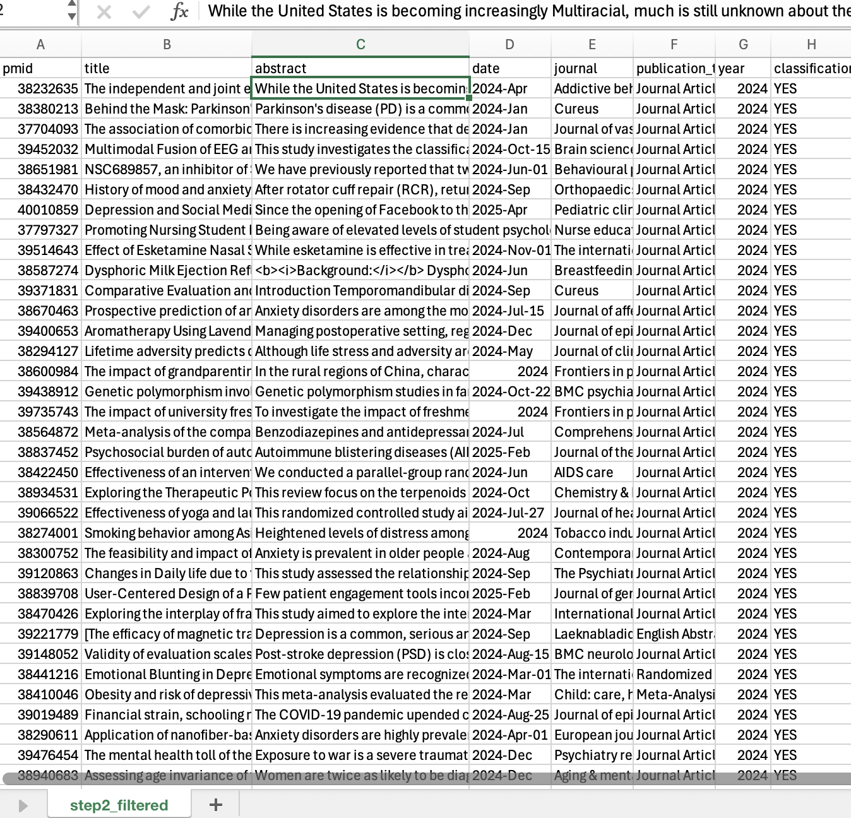
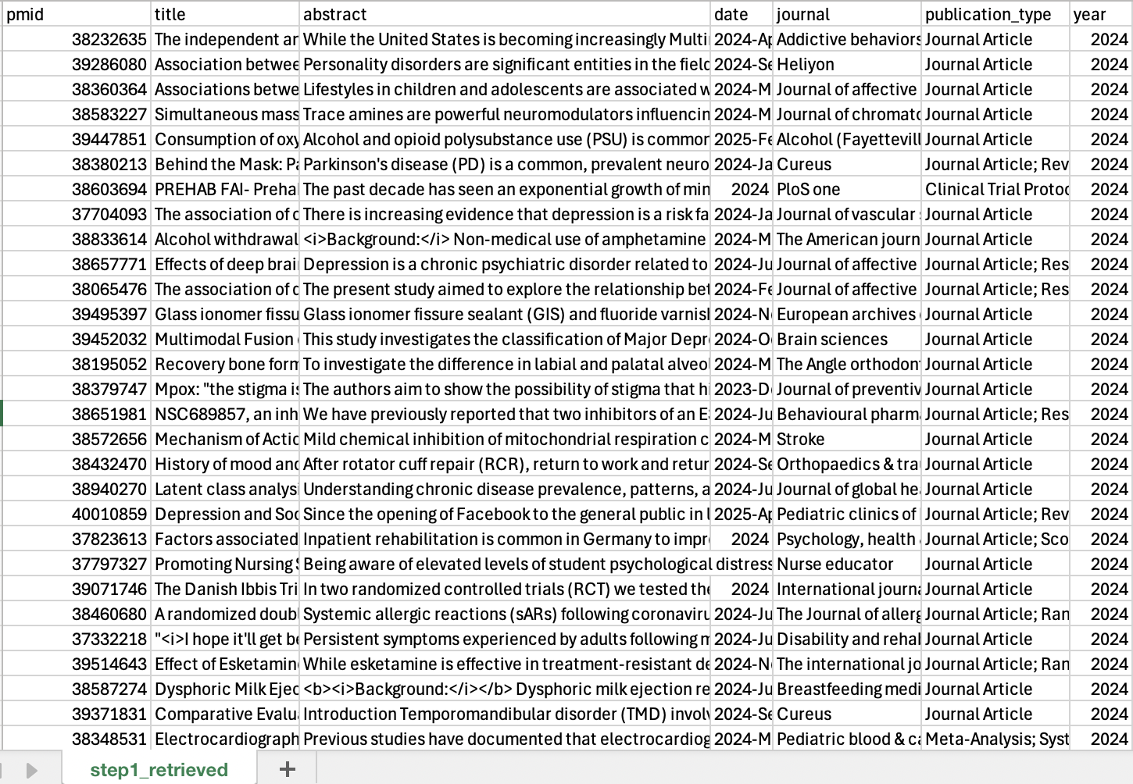
Output csv –retrieved & filtered
Notes:
On the backend

Slide 18
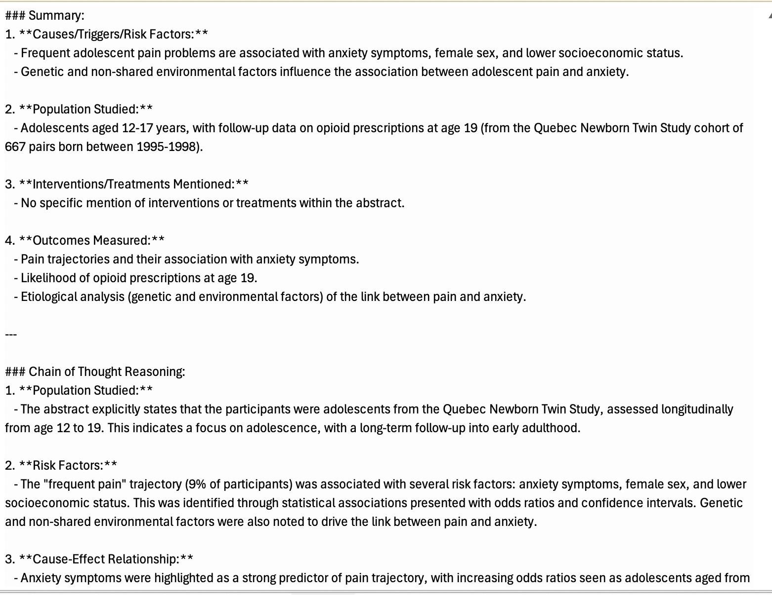
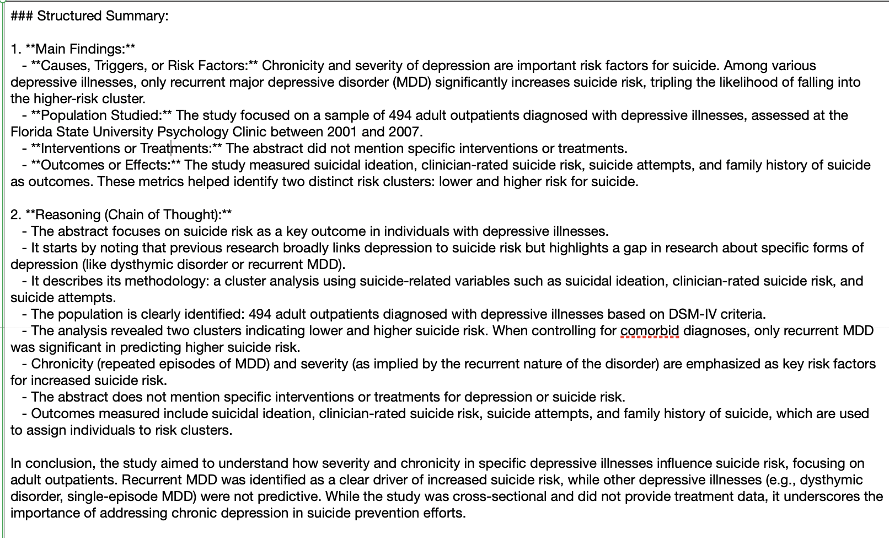
Output csv -extracted
Notes:
Output csv scan -extracted

Slide 19
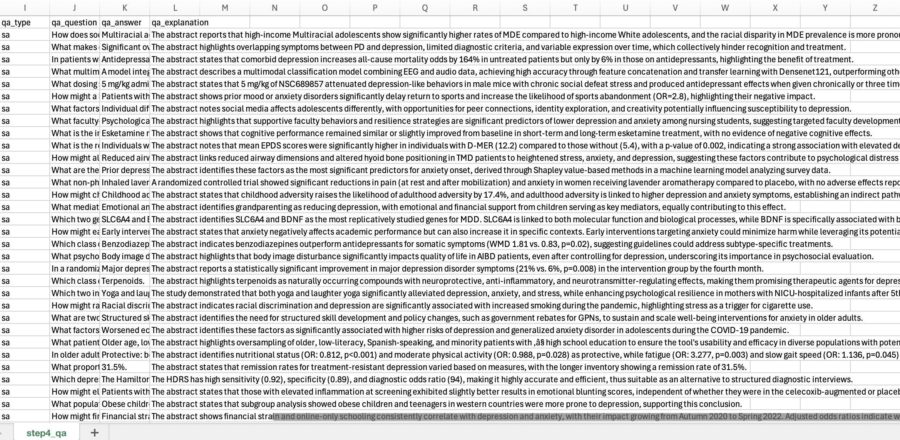
Output csv –QA generated

